Slide 1
5-Star Students

Slide 2
What can 5-Star Students do?
Track Activities
Track and record event attendance
Award positive behavior points
Keep intervention records
Manage class rosters and print barcodes
Manage rewards (in-person and virtual!)
Surveys and Voting
Emergency Check-in
Health Screening Surveys and Health Checks
Assign and view Hall Passes

Slide 3
Sign in to your account
You should receive an email invitation to set up your password
https://5starstudents.com
Download the 5-Star Students Manager app to scan IDs with a mobile device

Slide 4
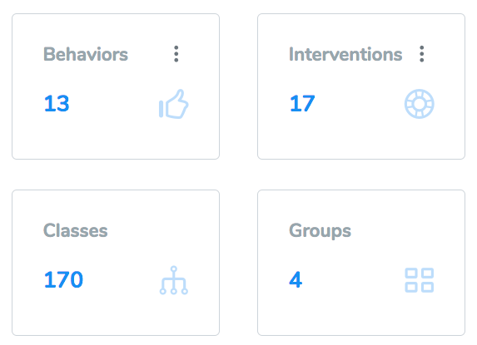
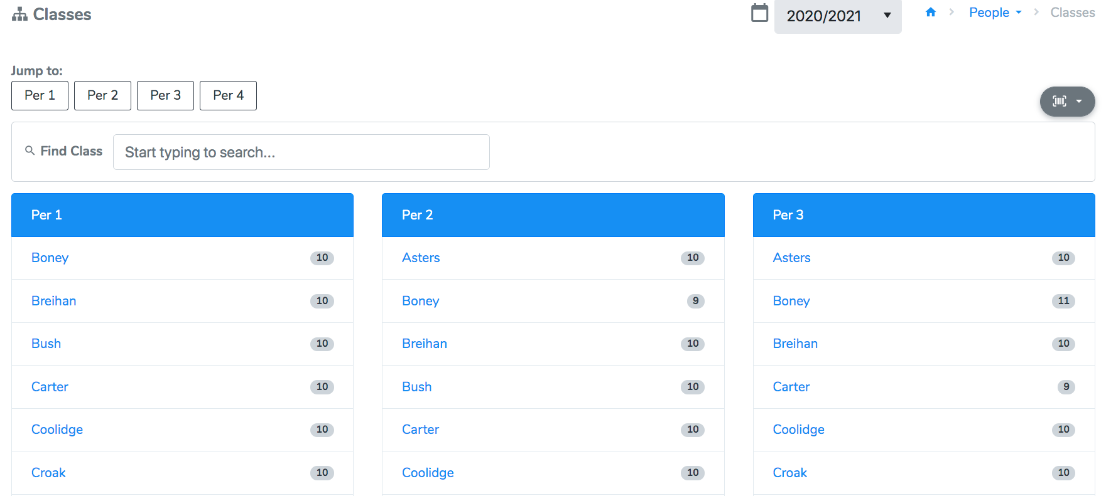
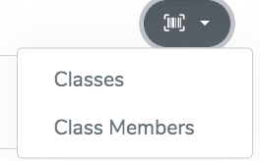
View and Manage Your Classes
Download student barcodes
Download class barcodes: a single barcode that represents everyone from that class

Slide 5
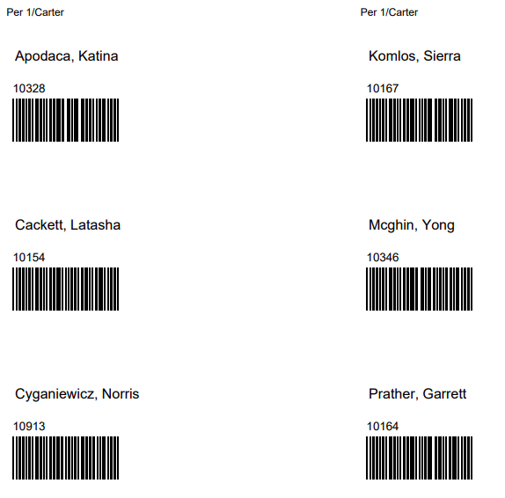
Class Barcodes
Class Member Barcodes

Slide 6
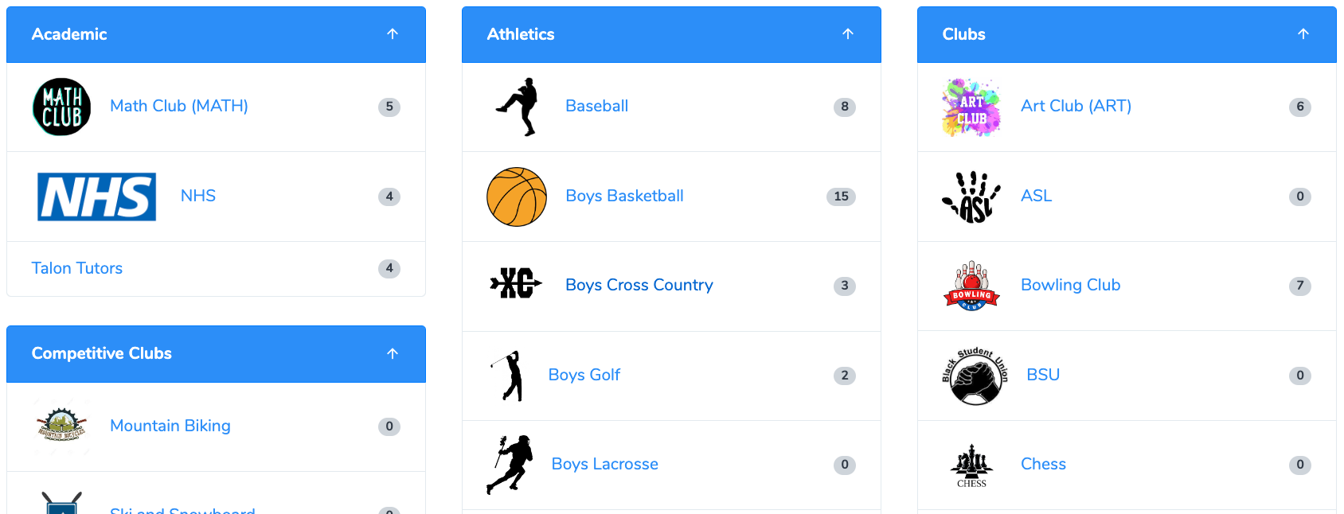
Activities - Organizations/groups that individuals belong to
Ex) clubs, athletic teams, scholastic groups, honor roll

Slide 7
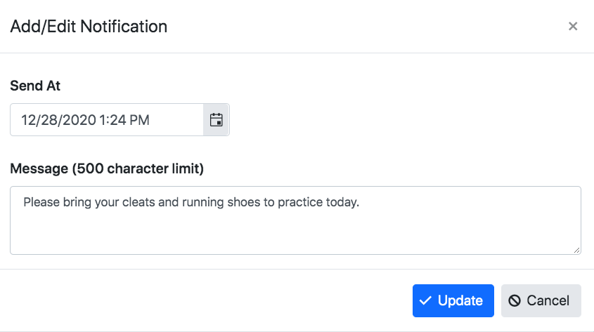
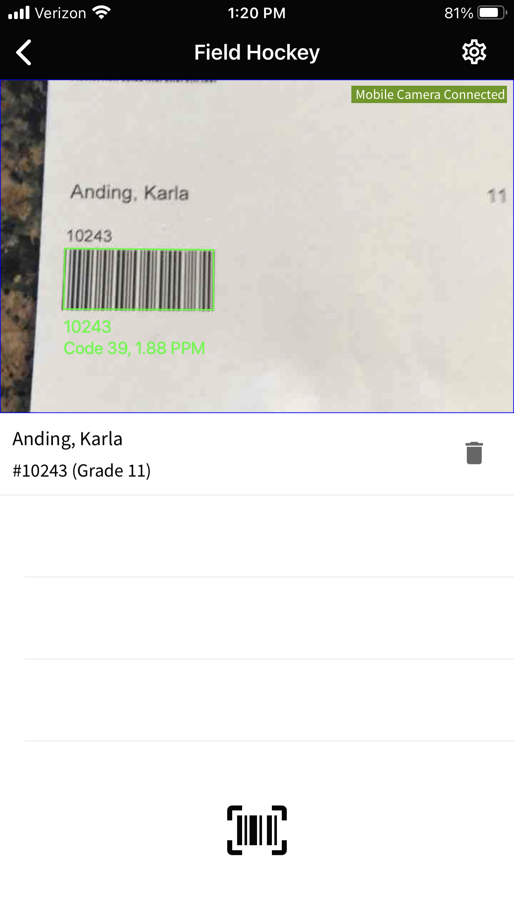
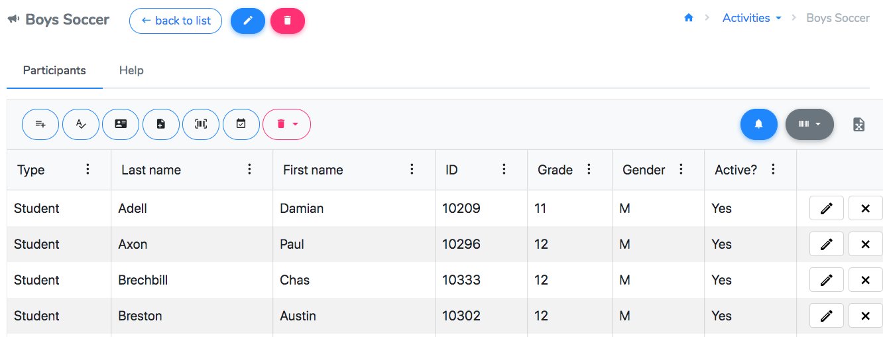
Activities
Add participants from the website or phone
Connect rosters to meetings from your calendar
Send notifications to members (for schools with the Student Mobile App)

Slide 8
Add from list: manually select students from the roster
Import from file: upload an excel or csv file
Add from names: manually enter or copy/paste a list of student names
Import from scanner: upload the BARCODES.TXT file from a mobile scanner
Add from IDs: manually enter or copy/paste a list of student IDs
Qualify from events: update participants based on event attendance

Slide 9
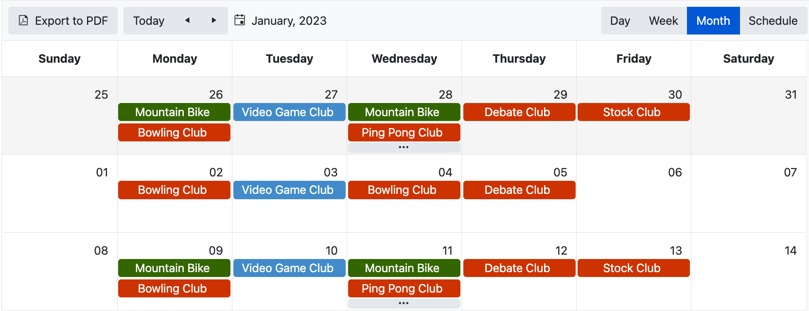
Events - Happenings that students attend
Ex) dances, spirit days, club meetings

Slide 10
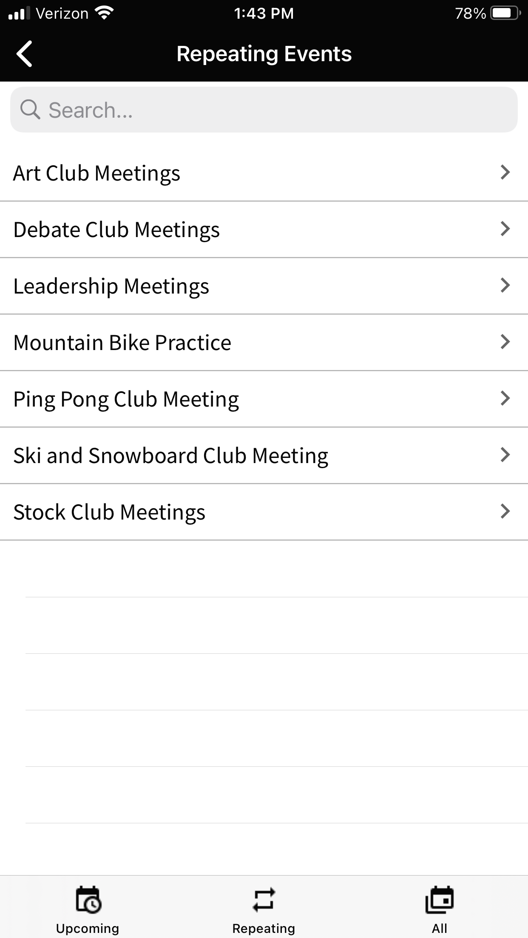
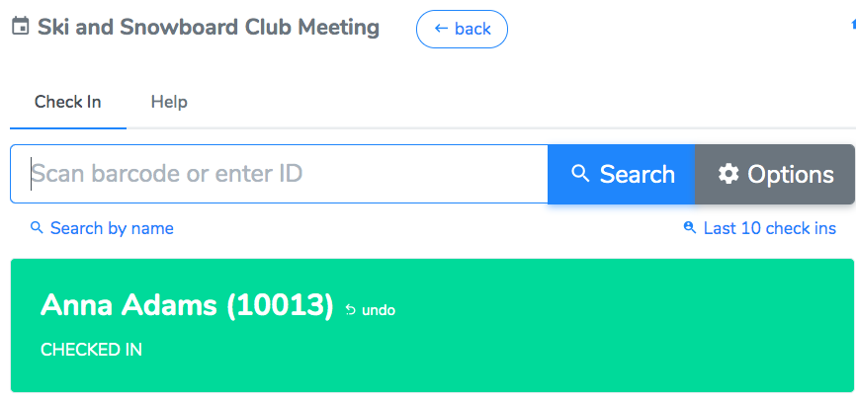
Events
Record attendance for in-person or online events
Use a mobile device, barcode scanner, or take roll

Slide 11
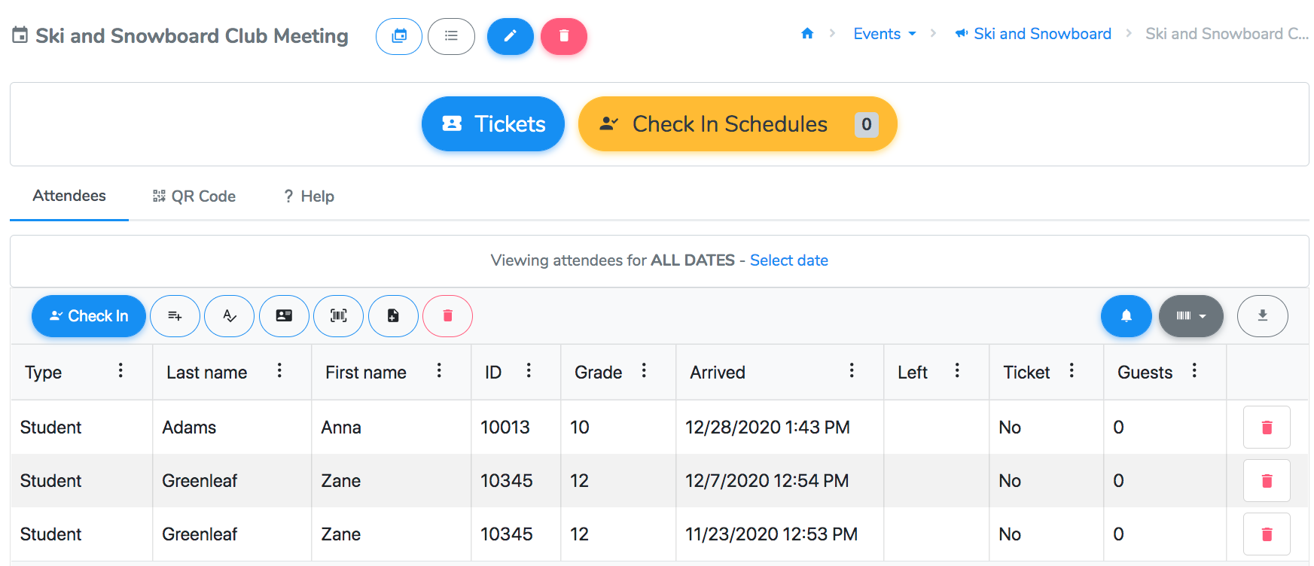
Add from list: manually select students from the roster
Import from file: upload an excel or csv file
Add from names: manually enter or copy/paste a list of student names
Import from scanner: upload the BARCODES.TXT file from a mobile scanner
Add from IDs: manually enter or copy/paste a list of student IDs
Live check in: manually enter or scan student IDs – use this for live feedback (tickets and no privileges)

Slide 12
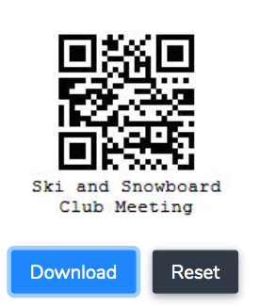
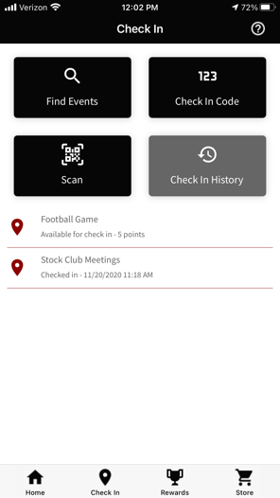
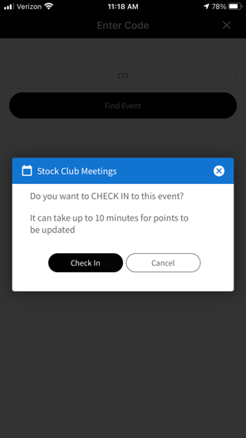
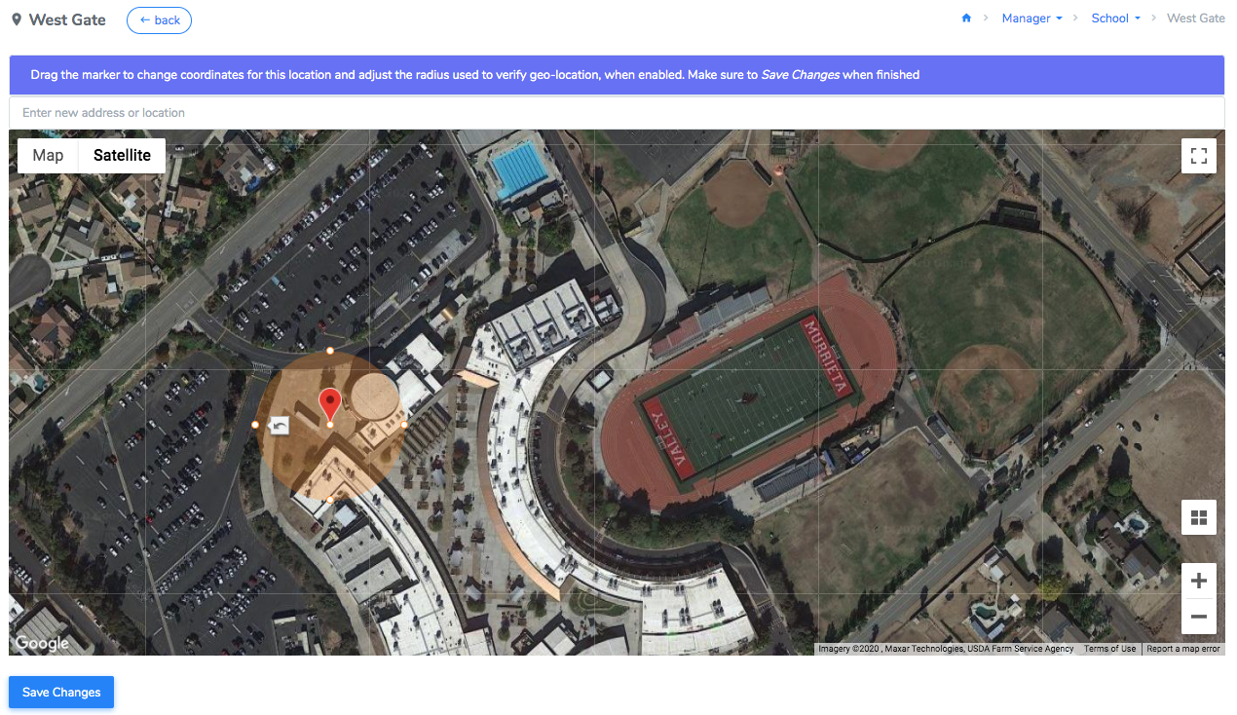
Events – using the Student Mobile App
Self check-in options:
Scan QR Code
Enter a check-in code
School locations
Proximity Beacons

Slide 13
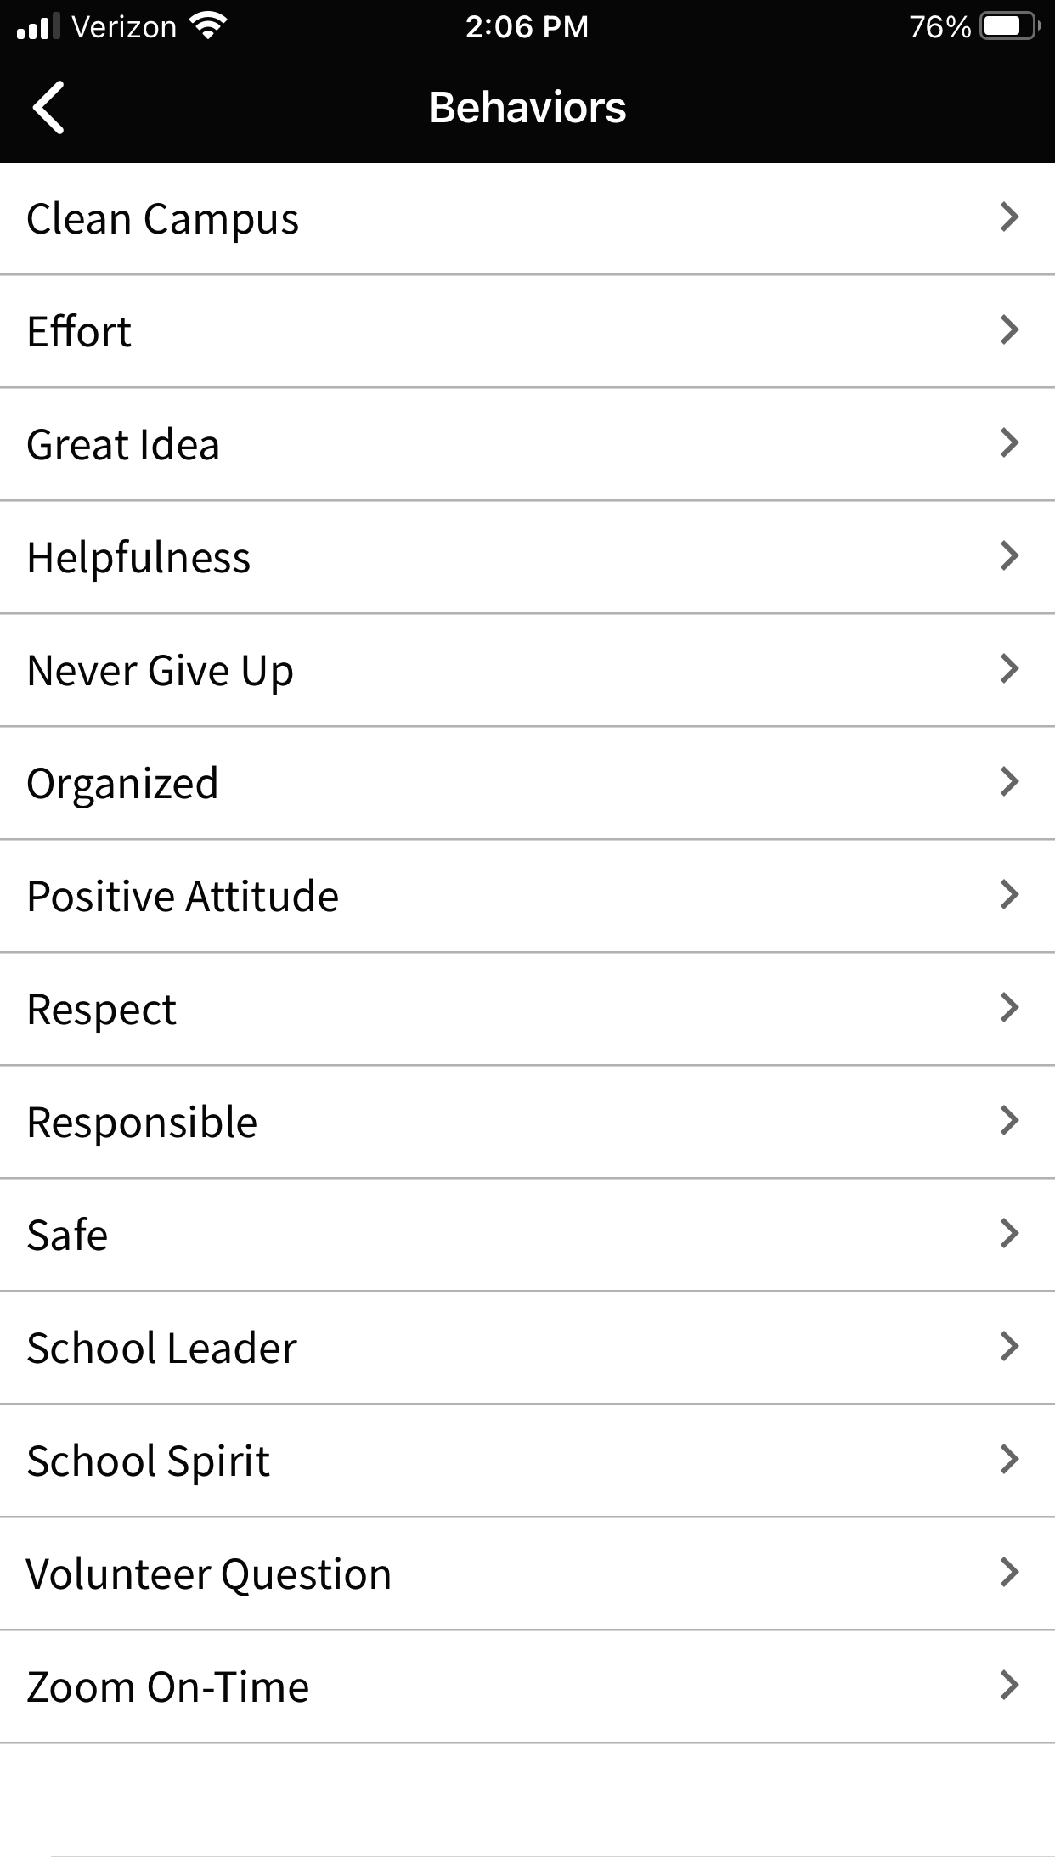
Behaviors - Positive occurrences
Ex) Respectful, Campus Clean Up, On Time to Class
Award from a mobile device, barcode scanner, or class list

Slide 14
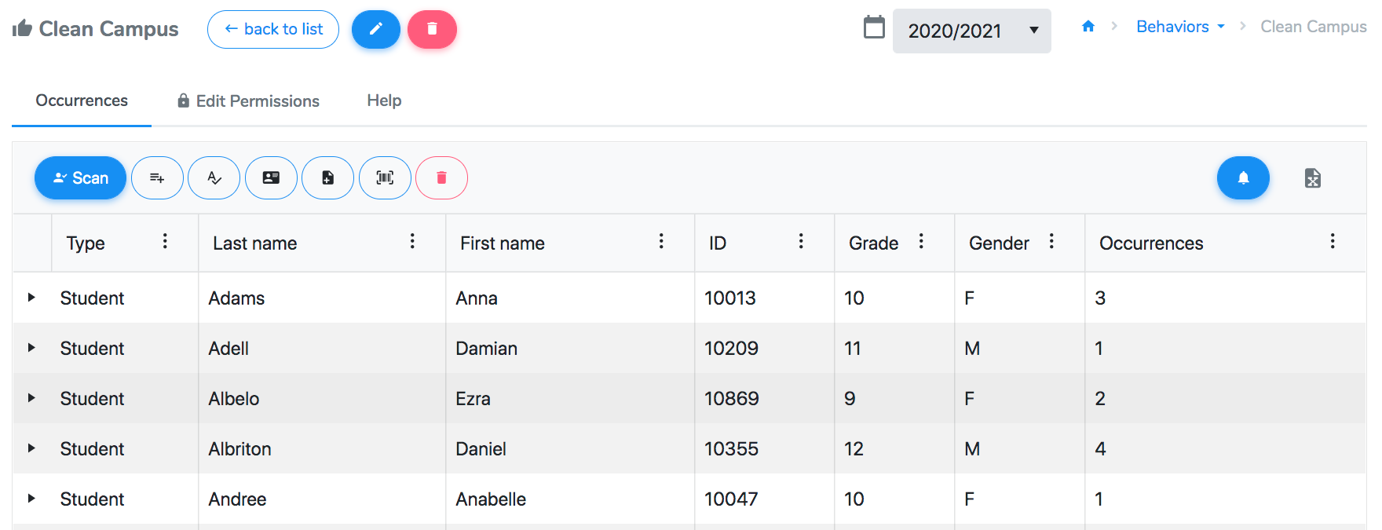
Add from list: manually select students from the roster
Import from file: upload an excel or csv file
Add from names: manually enter or copy/paste a list of student names
Import from scanner: upload the BARCODES.TXT file from a mobile scanner
Add from IDs: manually enter or copy/paste a list of student IDs
Scan: manually enter or scan student IDs

Slide 15
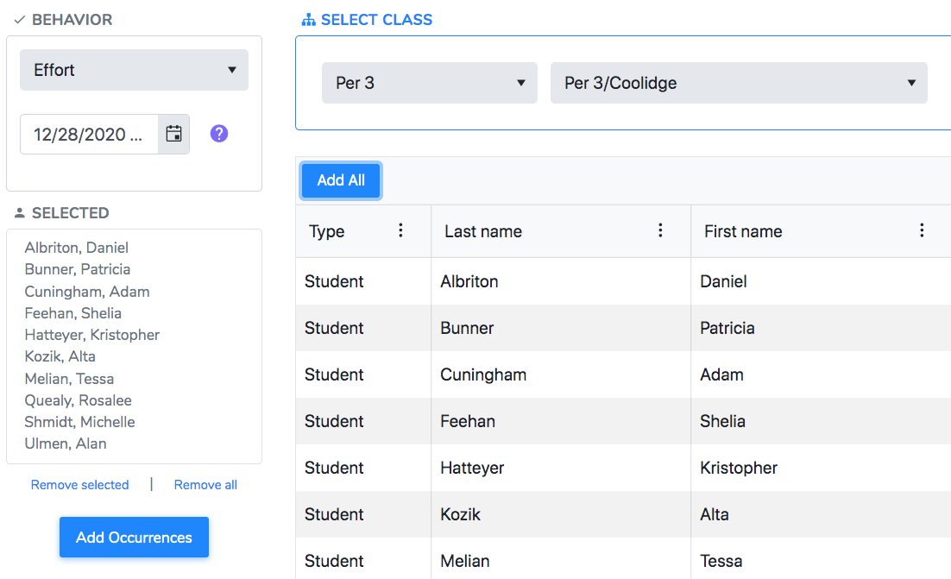
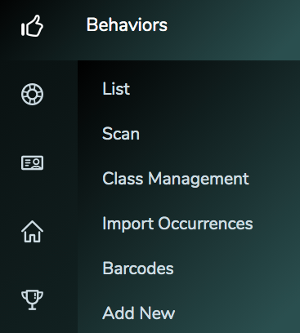
Behaviors
Class Management
Class barcodes

Slide 16
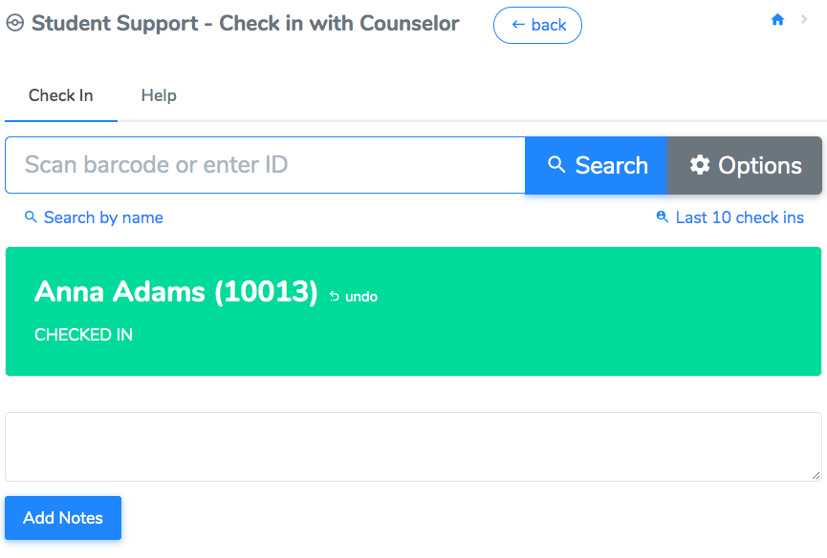
Interventions
Academic or support-driven events
Check-in with mobile device, barcode scanner, or self-check in methods

Slide 17
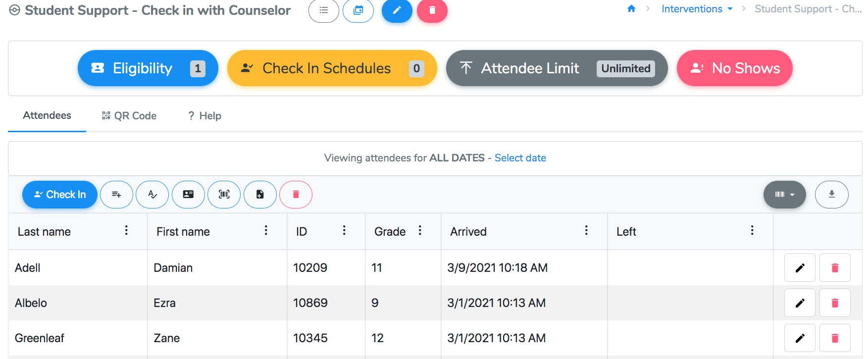
Add from list: manually select students from the roster
Import from file: upload an excel or csv file
Add from names: manually enter or copy/paste a list of student names
Import from scanner: upload the BARCODES.TXT file from a mobile scanner
Add from IDs: manually enter or copy/paste a list of student IDs
Live check in: manually enter or scan student IDs – use this for live feedback (eligibility and notes)

Slide 18
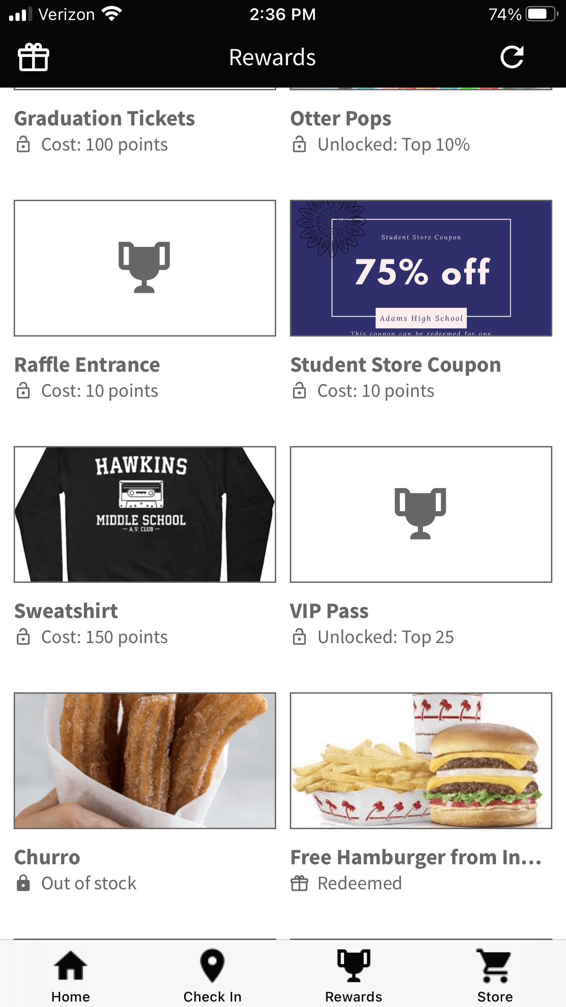
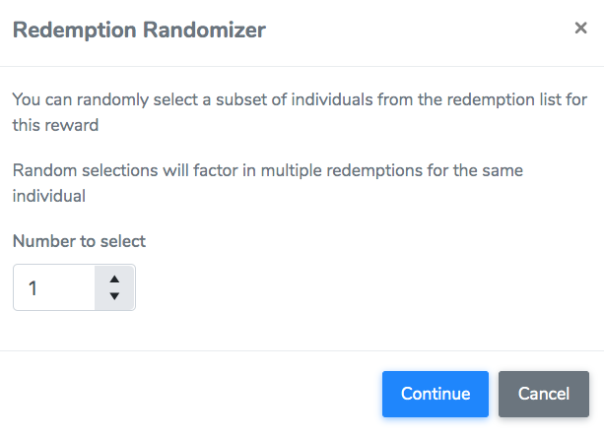
Rewards and Recognition
Manage an in-person or virtual store
Self-redemption option (ordering prizes from the student app or webpage)
Raffle prizes directly from the website

Slide 19
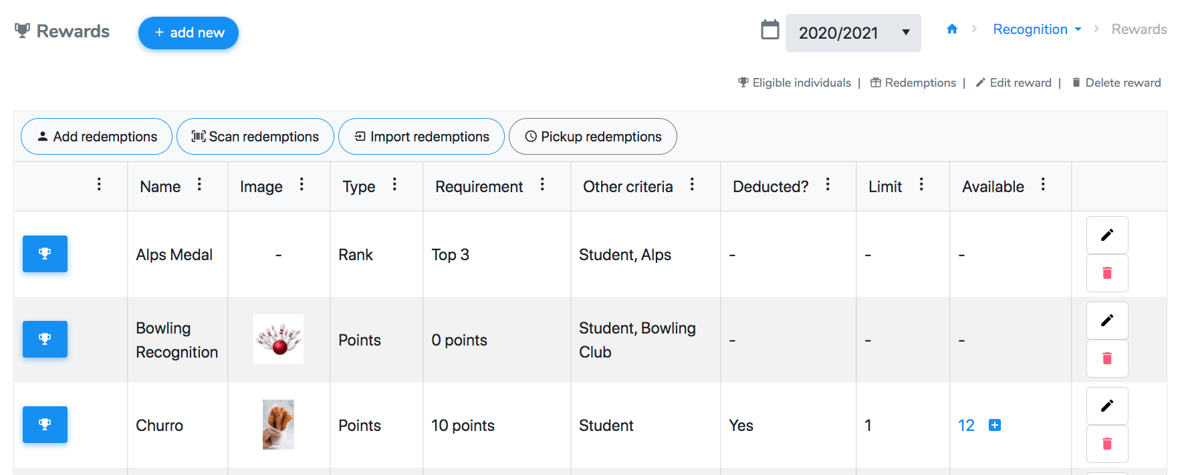
Manually redeem points for prizes
Import redemptions from a mobile barcode scanner
Scan reward barcodes for redemption
Mark off students when they pick up their online orders

Slide 20
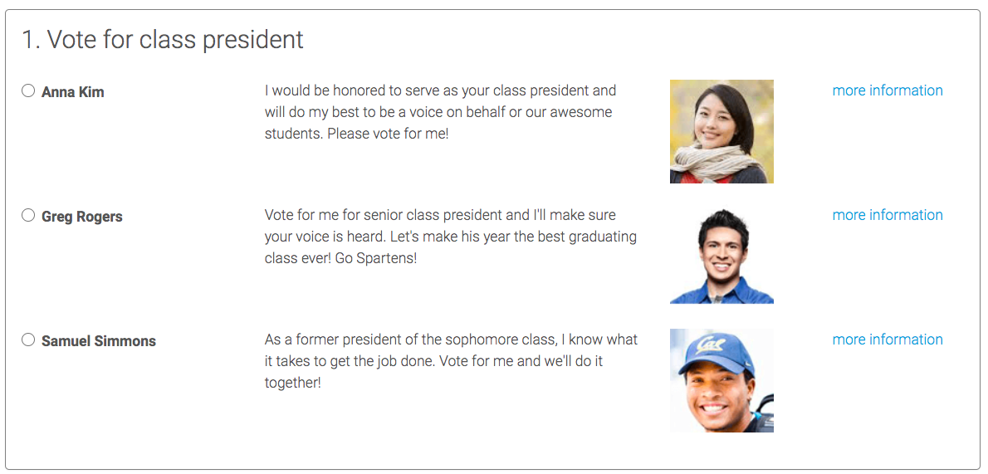
Surveys and Voting
Individuals can take surveys or vote using:
Student app
Link
Email
School Webpage
Select the list of individuals:
Sort by grade level, event attendance, activity participation, etc.

Slide 21
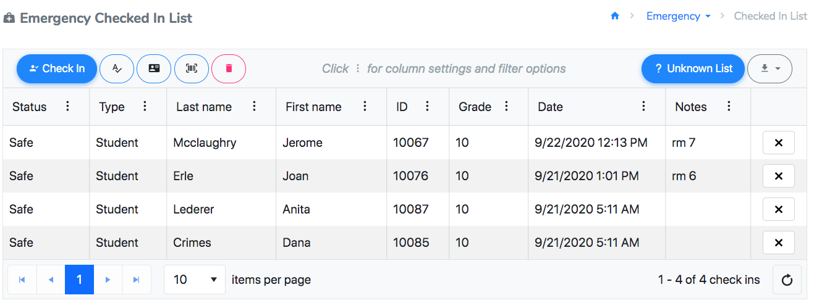
Emergency Check-In
Check individuals in during a drill or emergency
Use a mobile device or computer to enter the individual’s location and status
View the “unknown” or “missing” list

Slide 22
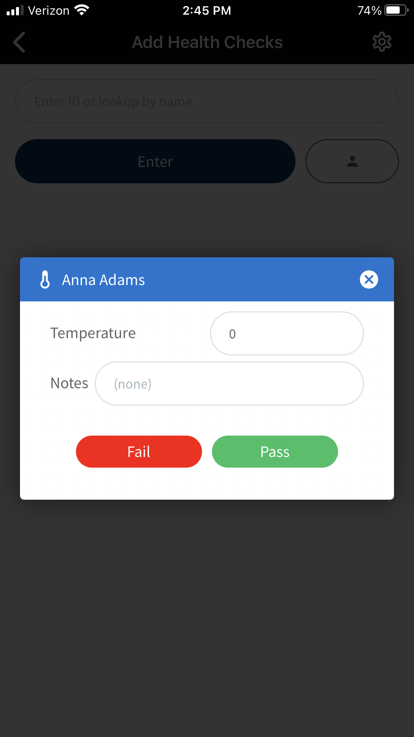
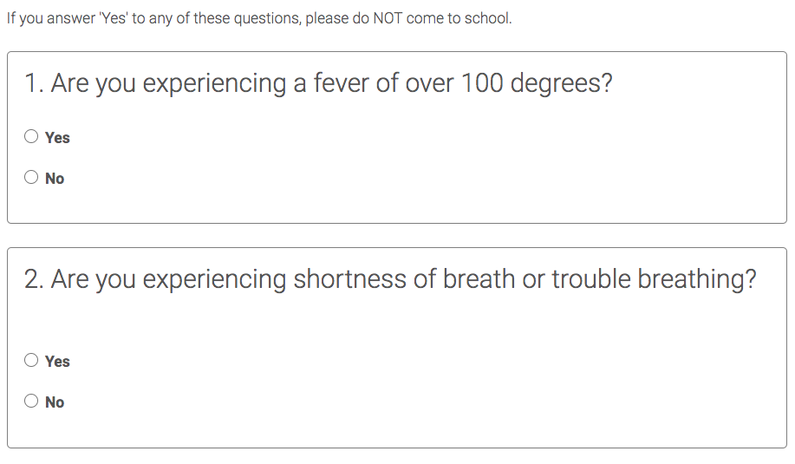
Health Screening Surveys and Health Checks
Create a custom health screening survey
Set how often it’s distributed
Check individuals in and mark their temperature and any notes

Slide 23
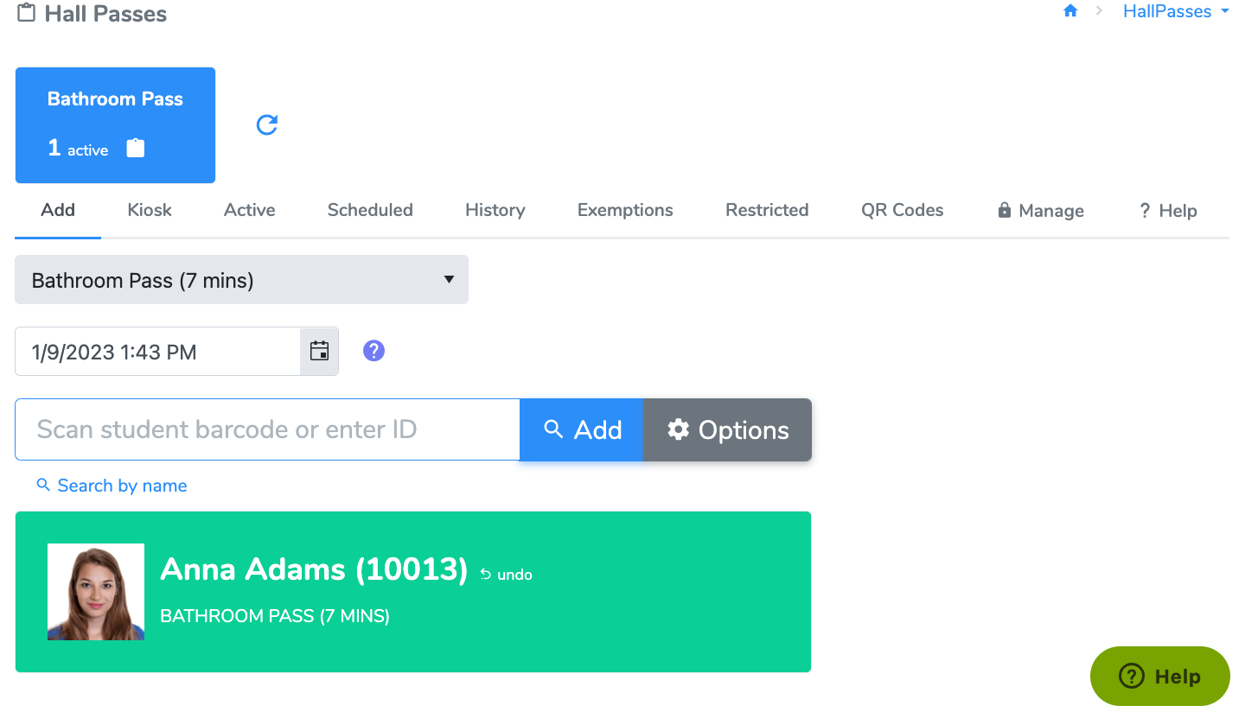
Hall Passes
Assign hall passes to students
View active, ending, and expired passes
Display QR code for students to scan in/out
Schedule future passes (athletic early release)
Manage restricted individuals and groups (i.e. Student A and Student B cannot receive a pass at the same time)

Slide 24
Assign Hall Passes
Option 1: assign from computer
Select the pass from the drop down menu
Scan or enter the student ID (use search by name if needed)
When the student returns, you can scan or enter their ID a second time to close the pass
Depending on the pass settings (determined by your site managers), the pass will show as expired until it is closed

Slide 25
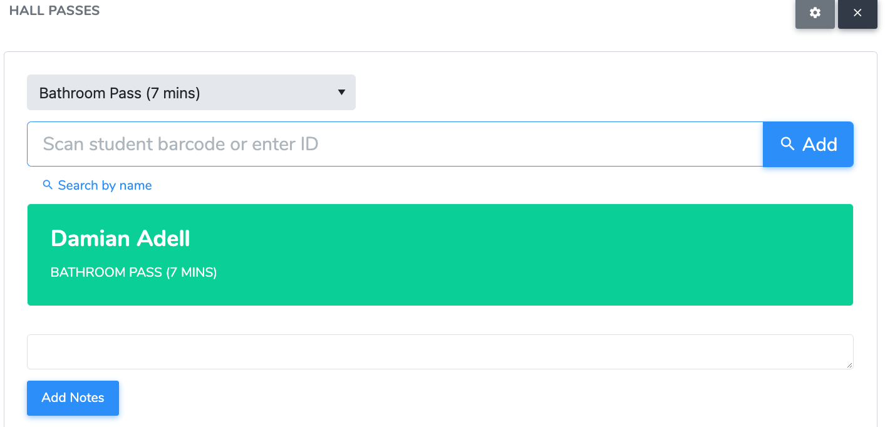
Assign Hall Passes
Option 2: kiosk mode
Create an unlock code (unique for each user) – this prevents students from exiting the screen and access other information in 5-Star
Set up your tab for students to be able to check in/out
Only passes with kiosk mode enabled will appear from the drop down menu
They can enter their ID, use a barcode scanner (if provided), or use the search by name

Slide 26
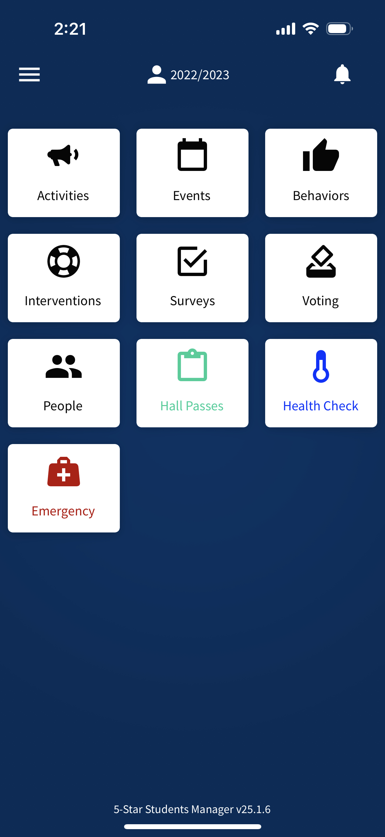
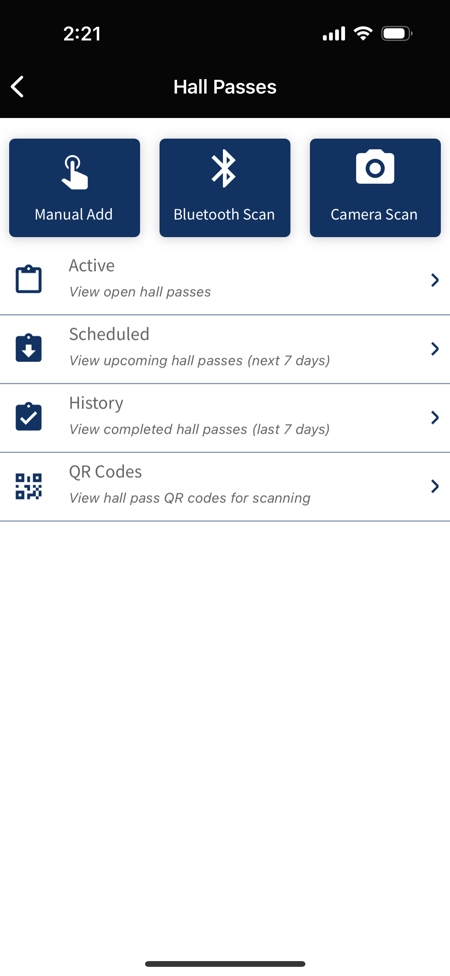
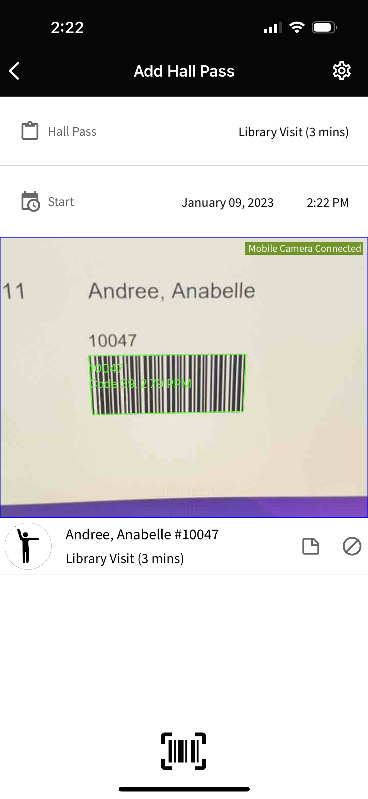
Assign Hall Passes
Option 3: Manager App
Choose one of the 3 options to add a pass
Manual add – type the ID or look up by name
Bluetooth scan – pair a Bluetooth scanner to your device
Camera Scan – use your device’s camera to scan the student’s barcode
View active and expired passes

Slide 27
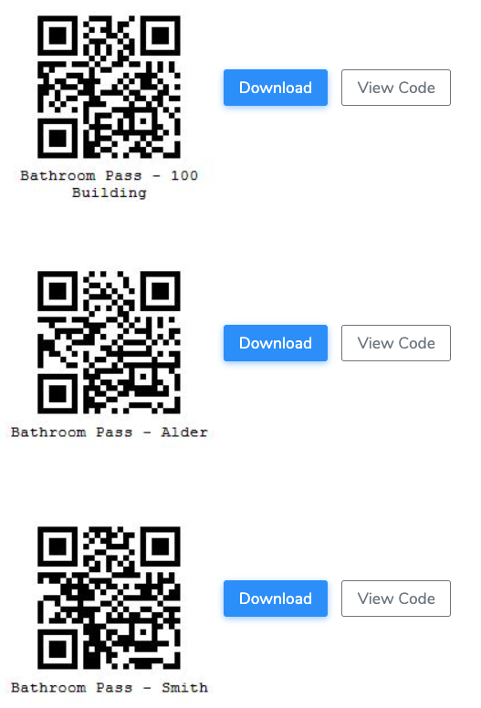
Assign Hall Passes
Option 4: QR Codes
Select the pass to download the QR code
Depending on your site, there may be multiple QR codes or a single QR code per pass
i.e. each teacher has their own QR code

Slide 28
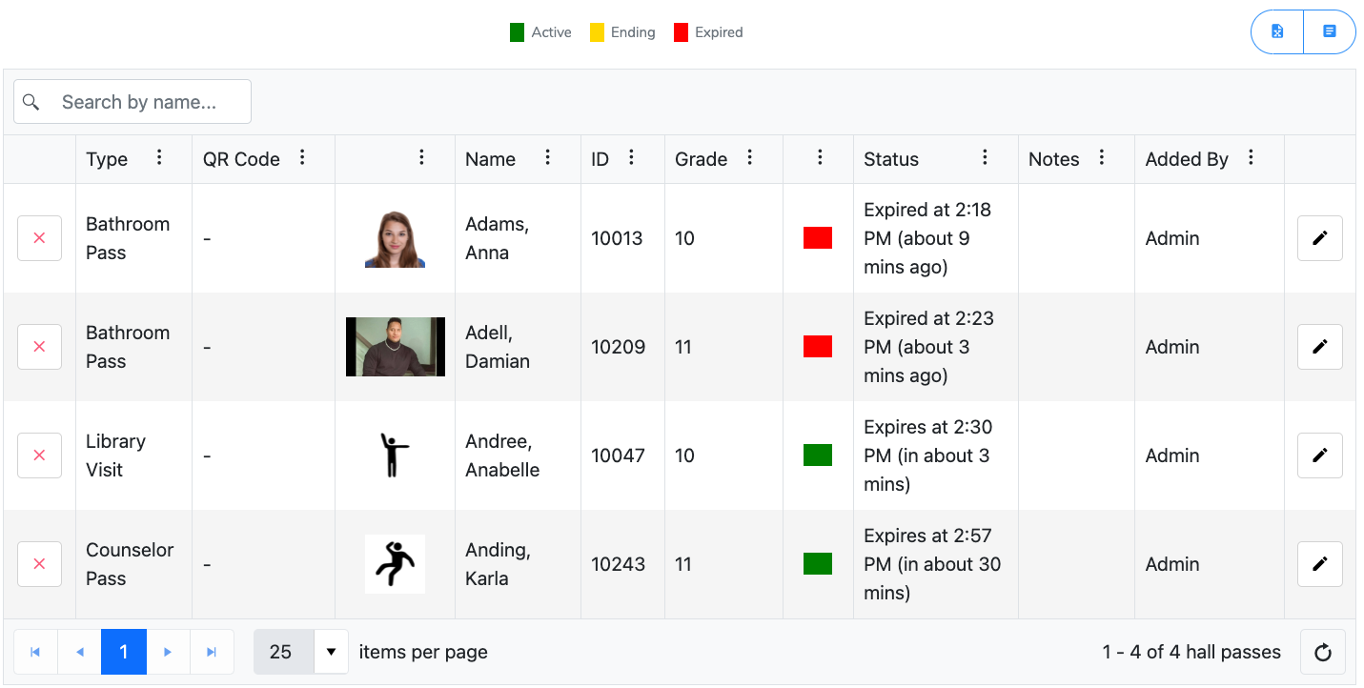
View Hall Passes
Option 2: kiosk mode
Create an unlock code (unique for each user) – this prevents students from exiting the screen and access other information in 5-Star
Set up your tab for students to be able to check in/out
Only passes with kiosk mode enabled will appear from the drop down menu
They can enter their ID, use a barcode scanner (if provided), or use the search by name

Slide 29
5-Star Students

