Slide 1


5-Star Students Staff Training

Slide 2
agenda
OVERVIEW
  Website and App Navigation
  Behaviors
  Hall Passes
  Rewards

Slide 3
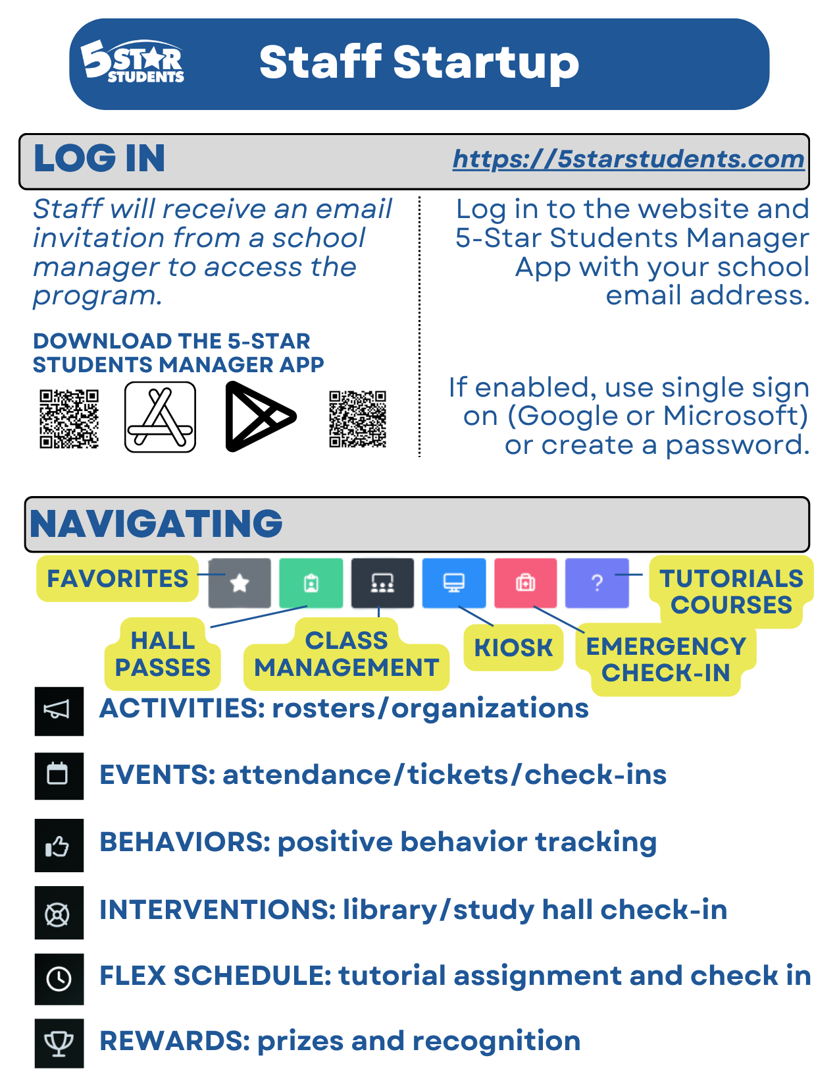
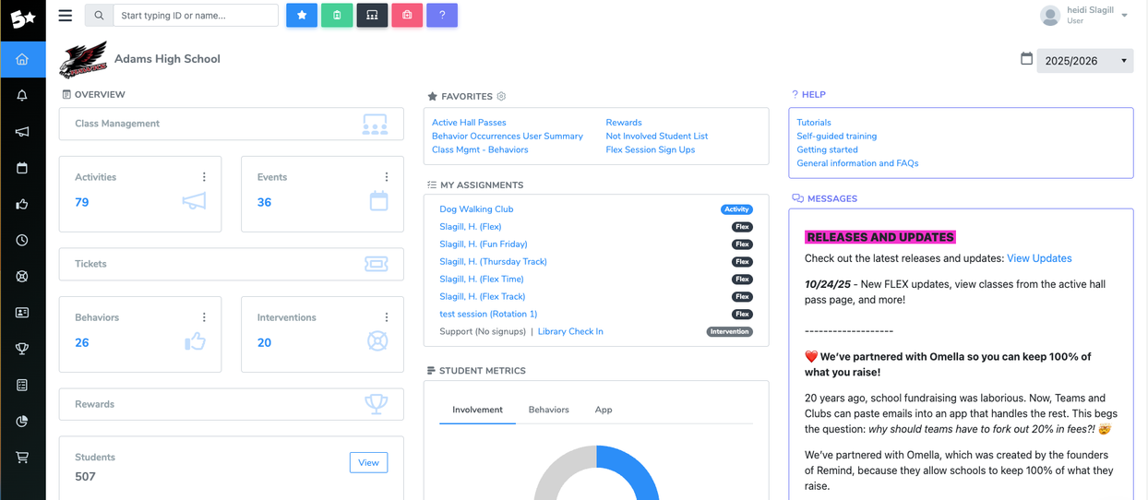
website
NAVIGATION
Check out the Staff Startup Guide

Slide 4

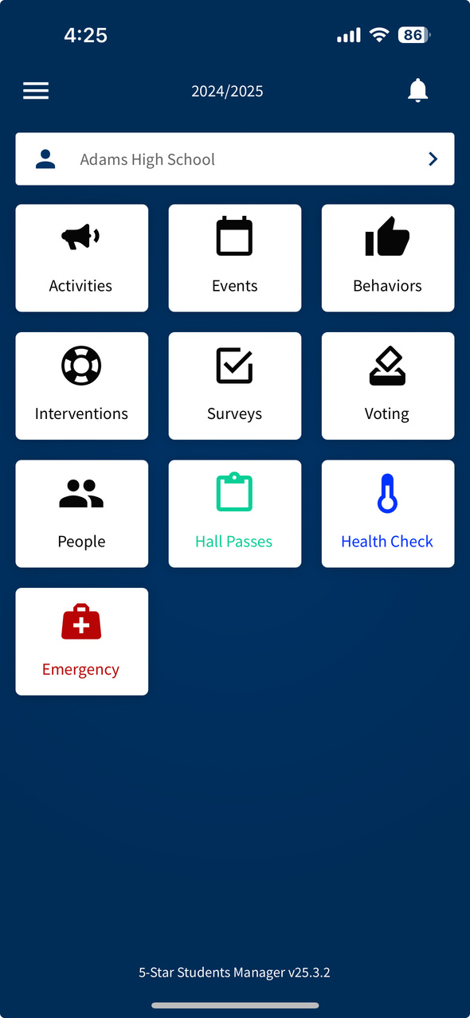
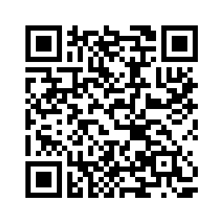

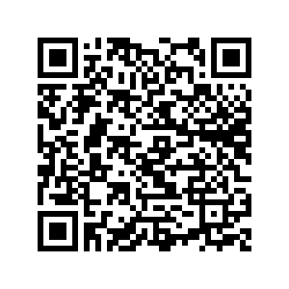

manager app
NAVIGATION
Download the 5-Star Students Manager App on any mobile device (phone, iPad, tablet)
  View/assign Hall Passes
  Issue behavior points
  Check indidivuals in (events and interventions)

Slide 5

class
BARCODES
DOWNLOAD
Downloading class barcodes simplifies attendance tracking and enhances classroom management for teachers and students alike, promoting efficiency.
  Navigate to the Classes page: https://app.5starstudents.com/Class/List
  Select the barcode icon in the top right corner
    Classes = singular barcode that represents ALL students in that class
    Class Members = individual barcodes for each student on that class roster

Slide 6
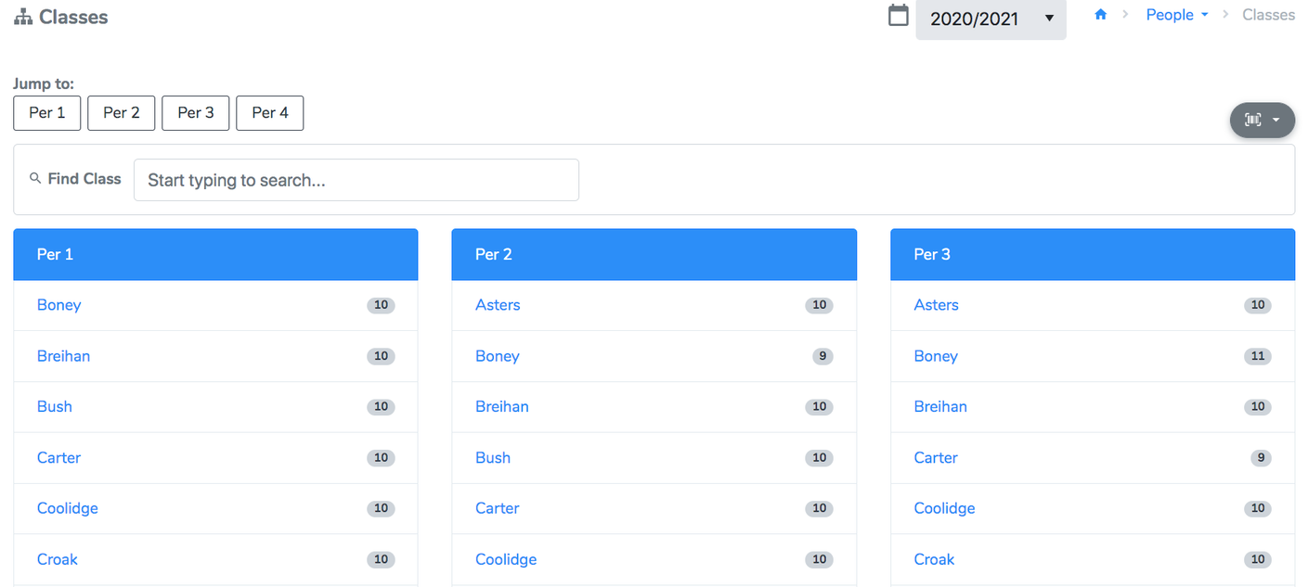
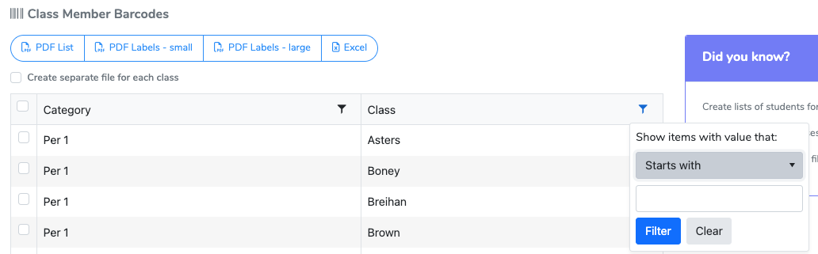
class
BARCODES
  Navigate to the Classes page: https://app.5starstudents.com/Class/List
  Select the barcode icon in the top right corner
    Classes = singular barcode that represents ALL students in that class
    Class Members = individual barcodes for each student on that class roster

Slide 7
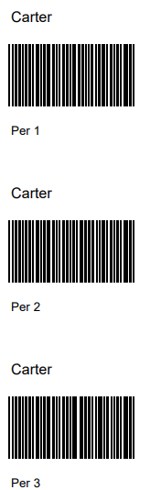
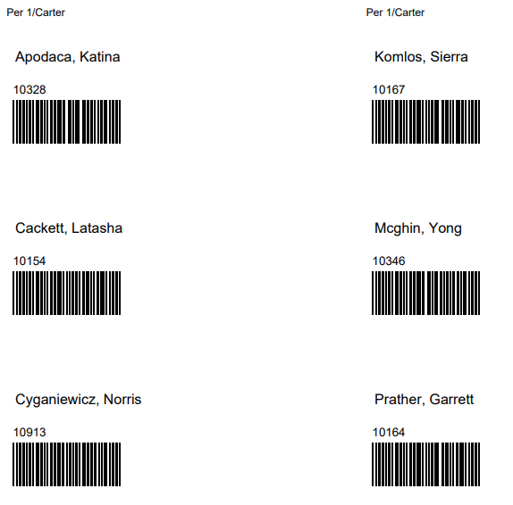
Class Barcodes
Class Member Barcodes
class
BARCODES

Slide 8
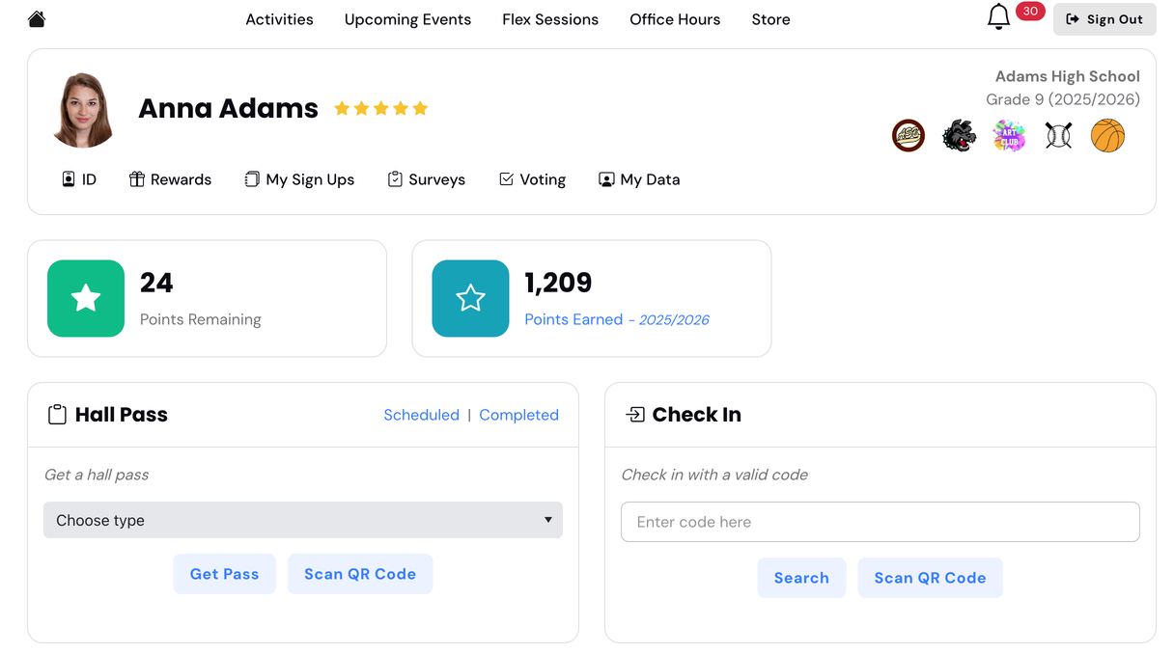

student
PERSPECTIVE
Students can download the 5-Star Students App or log into the school webpage to:
  View their points
  View their live, upcoming, and previous hall passes
  View their individual data (check-ins, participation history)
  View the school event calendar and list of Activities
  View and purchase rewards
  Display their Digital ID

Slide 9


behavior
MANAGEMENT
How to track and reward behavior
Giving Points
Class Management
Barcode Scanning
Teachers can quickly reward students by giving behavior points through the website and Manager App, streamlining the process for recognizing positive actions and achievements.
The Class Management tool allows teachers to efficiently issue points via their class roster(s).
Utilizing barcode scanning for behavior management simplifies the tracking process, allowing both teachers and students to engage seamlessly, with options for manual entry or camera scans for convenience.

Slide 10

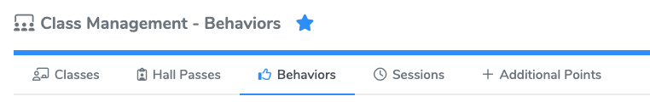
class
MANAGEMENT
  Navigate to the Class Management
  Click the Behaviors tab
  Mark the page as a favorite

Slide 11
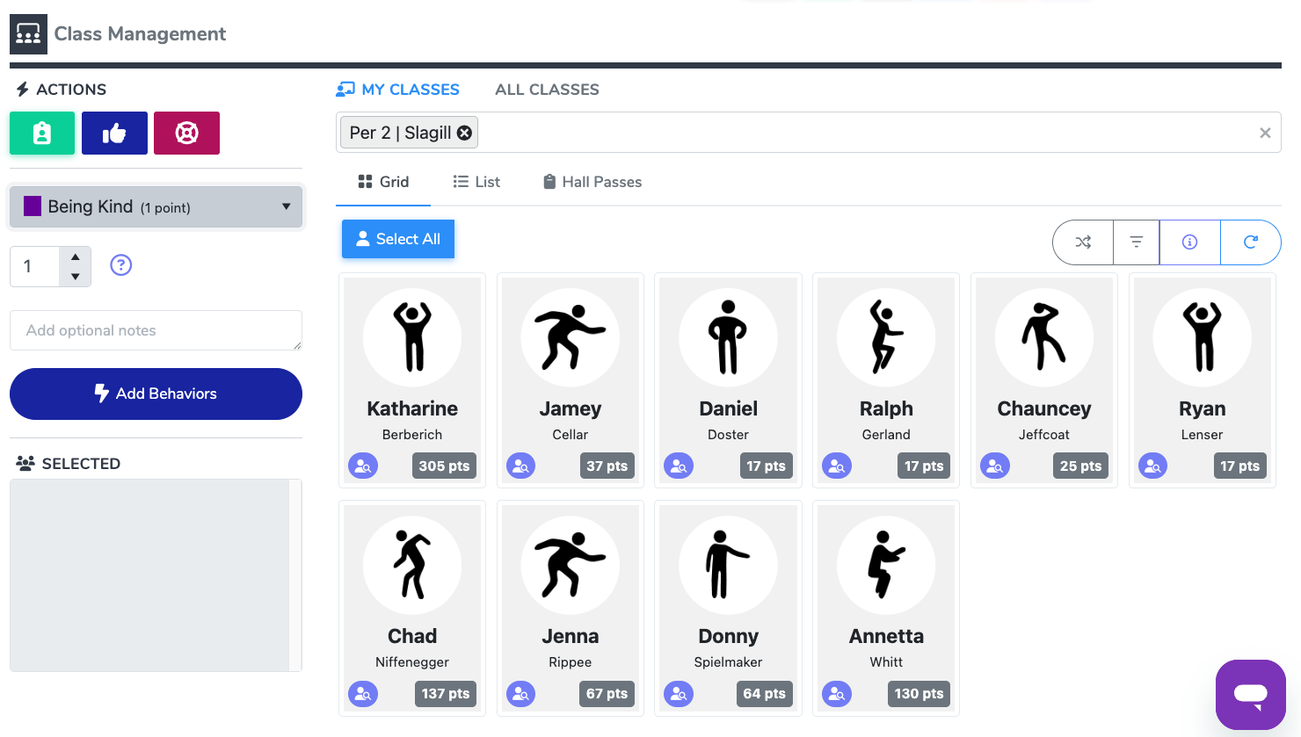
class
MANAGEMENT
  Select your roster(s)
  Click the student(s) name from the list to add them to the selected box
    use the Select All button to add all of the students
  Select the behavior
    use the multiplier (optional)
  Click Add Behaviors to save

Slide 12
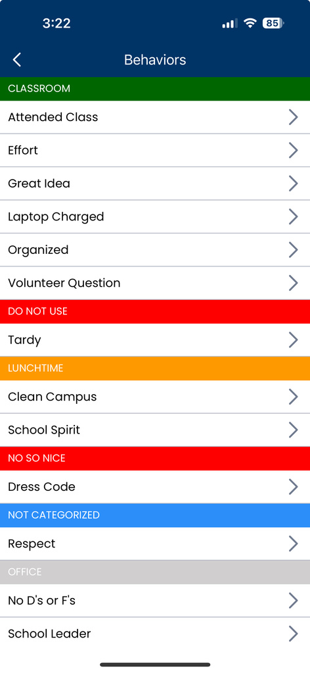
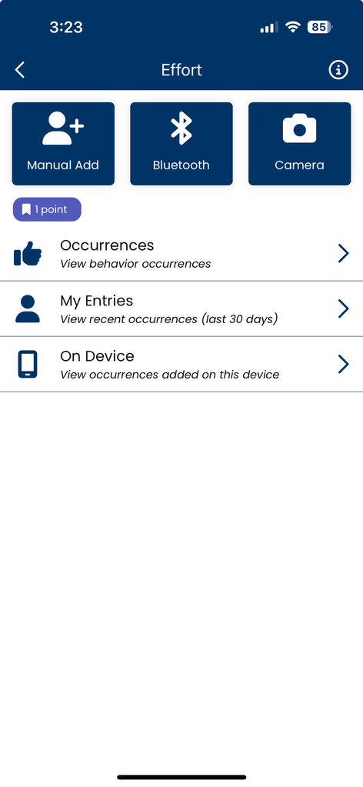
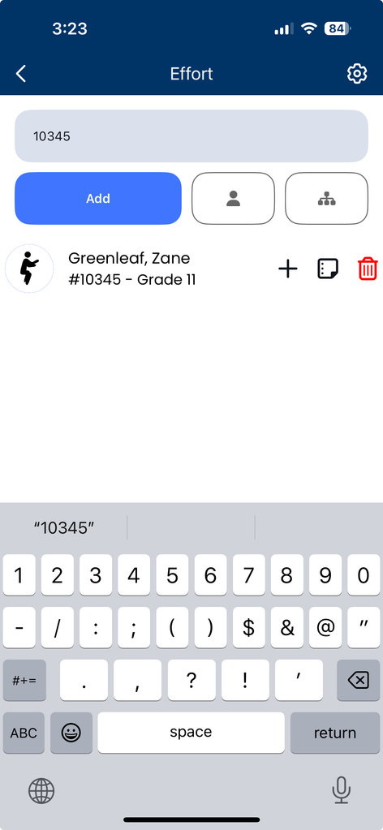
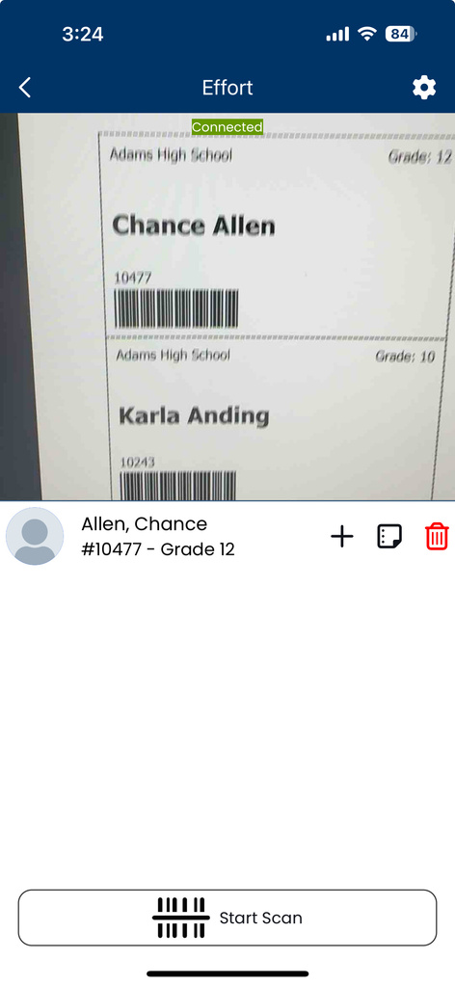
manager
APP

Slide 13


behavior
REPORTS
Student specific reports:
  Use the search bar at the top of any page to pull up a student’s profile. View their points, behavior occurrences, and more
  Behavior Occurrences by Student detail report
  Students with No Behavior Occurrences detail report
Schoolwide metrics: https://app.5starstudents.com/Data/BehaviorMetrics
Usage reports:
  Grade Level Summary detail report
  Behavior Occurrences User Breakdown detail report

Slide 14

hall pass
RULES
Managers (school admin) can set up different rules/restrictions for hall passes
Individual Limits
Blackout Schedules
QR Code Passes
  Time restrictions
  Daily individual limit
  Active limit
  Individual restrictions
  Group restrictions
  Cool down periods
Certain times are designated as blackout periods, during which hall passes cannot be issued to maintain classroom focus and minimize disruptions during critical learning times.
Admin can create teacher-specific QR codes that students can scan with their app OR chromebook

Slide 15
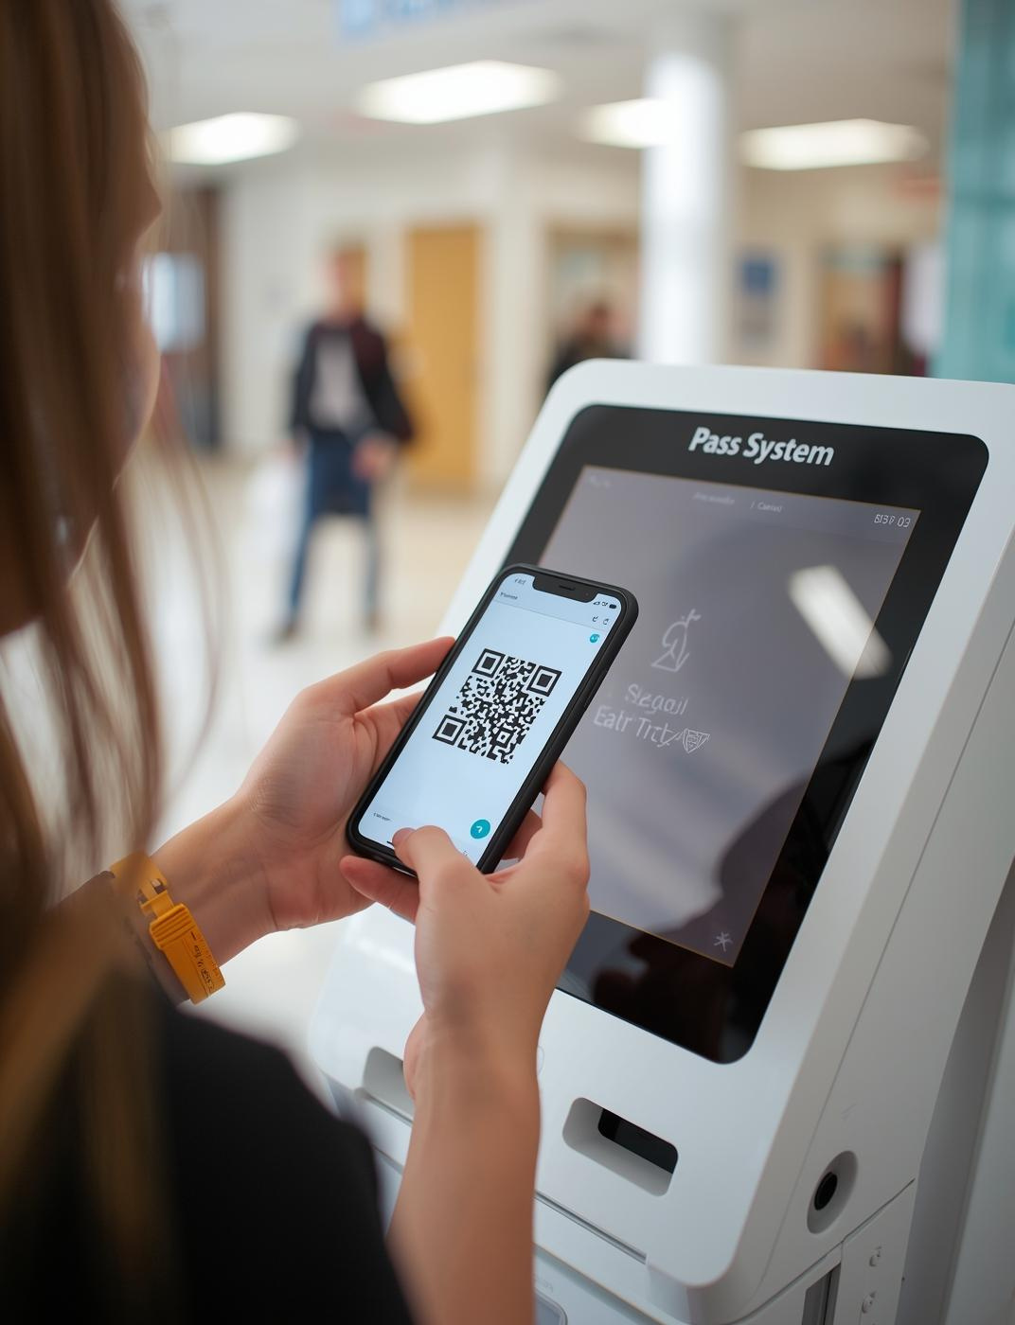
open & close
PASSES
  Manually – website
  Class Management
  Kiosk
  QR codes
  Manager App
  Schedule future passes

Slide 16
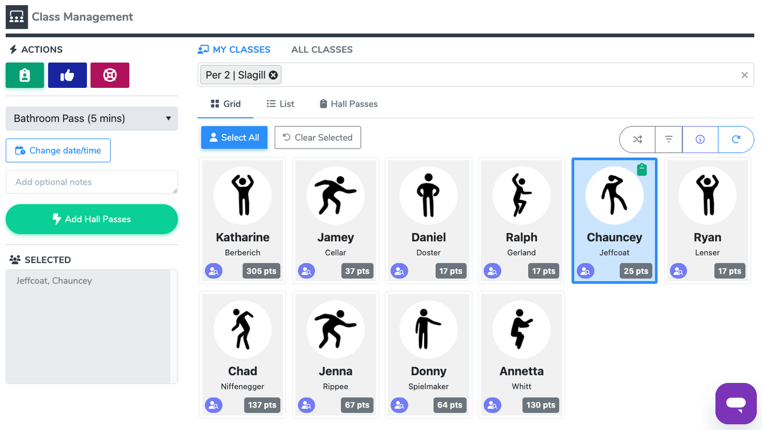
open & close
CLASS MANAGEMENT

Slide 17
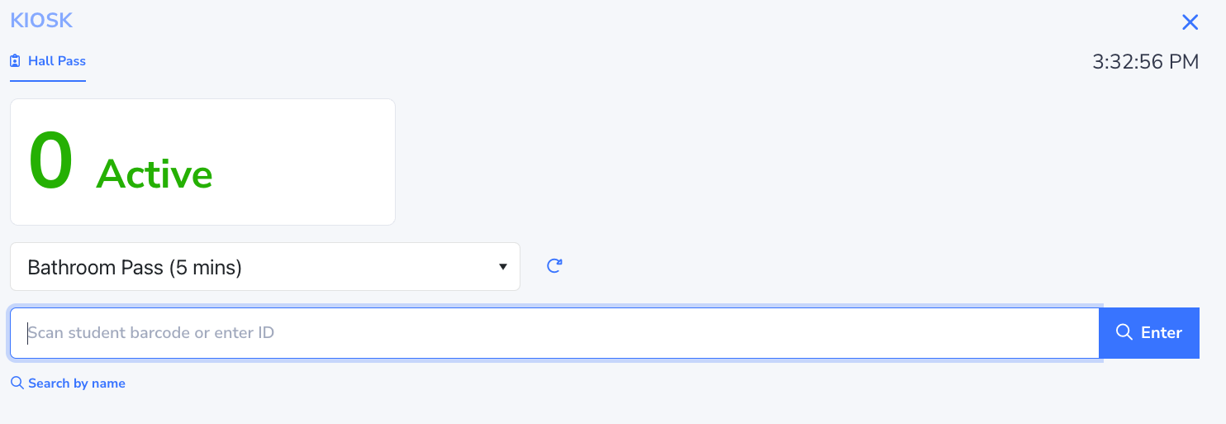
open & close
KIOSK

Slide 18
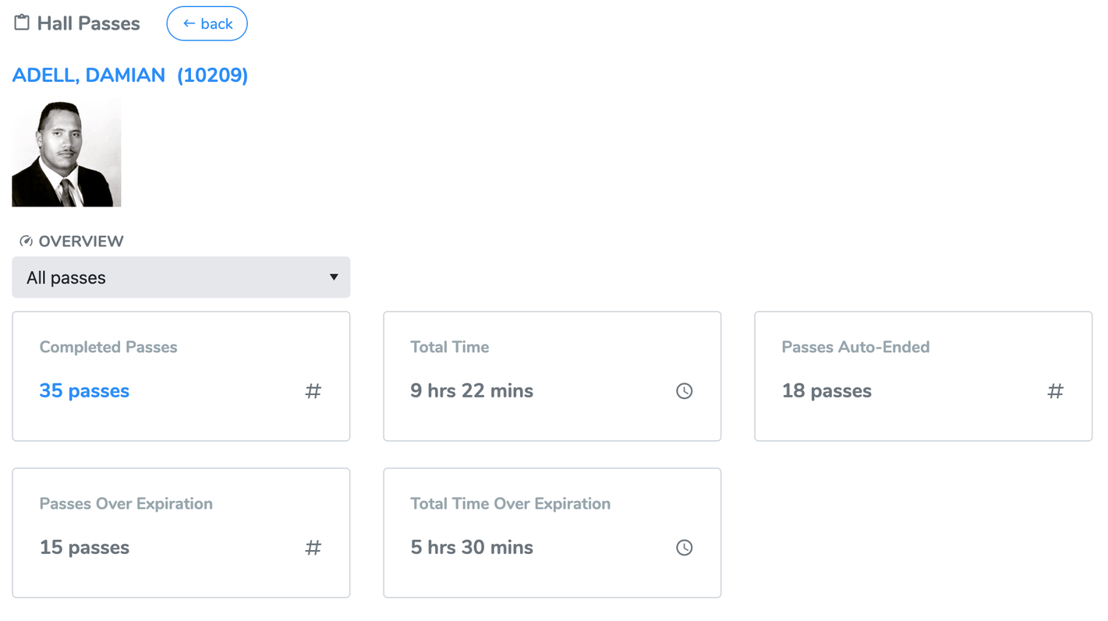
hall pass
REPORTS
  Hall Pass dashbooard - individual student
  History page - filters
  Hall Pass Student Summary

Slide 19

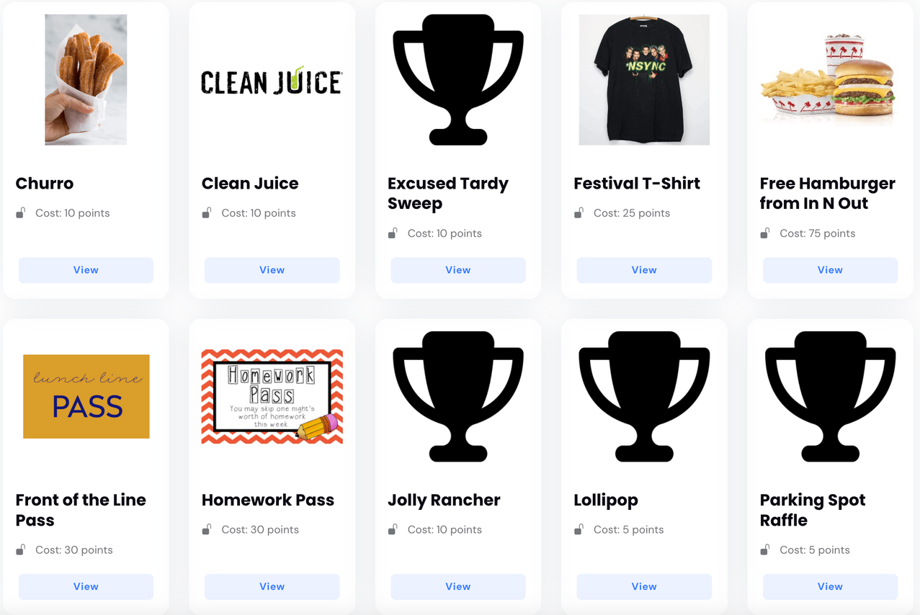
rewards
OVERVIEW
Students can earn points for attending events, joining activities, exhibiting positive behavior, checking into an intervention (i.e. tutoring), completing survey/poll
Rewards
  Rewards are SCHOOLWIDE
  Students can redeem in person or through their 5-Star account

Slide 20
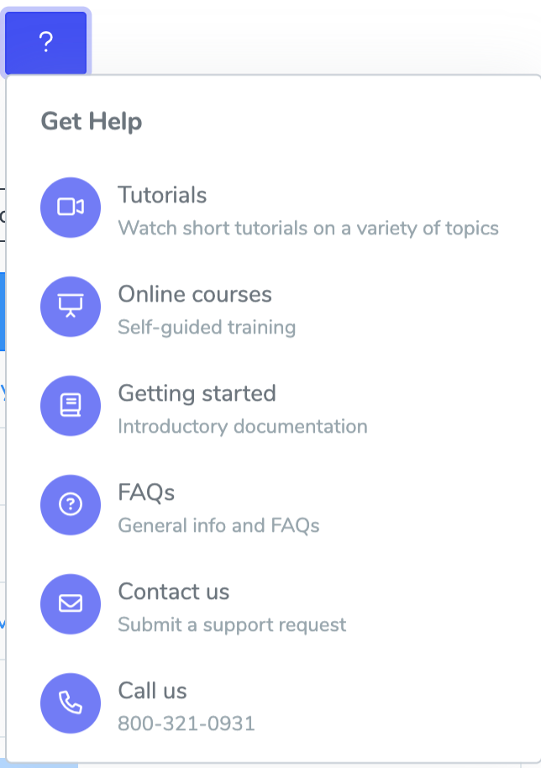

help
DOCUMENTATION

Slide 21
5-Star Students Staff Training

